Slide 1
TwitterBase – helps you tweet
Jesper Sam Sørensen
May 2017

Slide 2










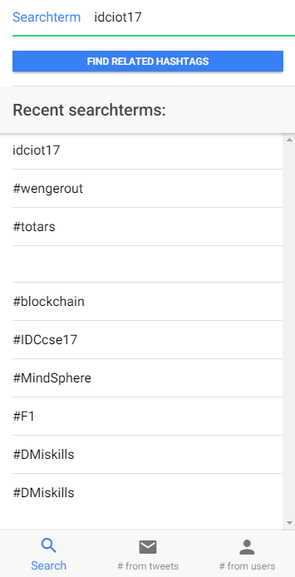
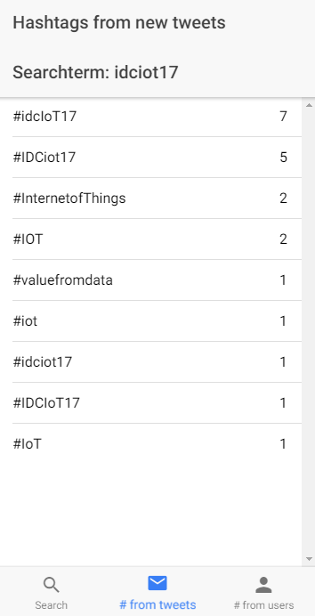
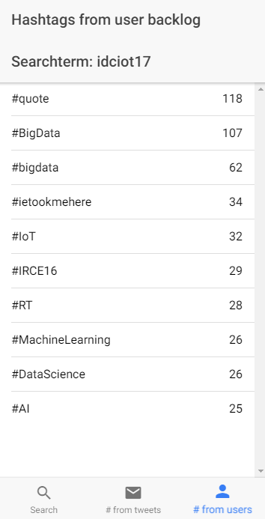


twitterapp-775ef.firebaseapp.com
Search term or hashtag
Uploaded to firebase
Grabbed by worker on Heroku
Returning results to firebase
Related hashtags, users’ hashtags

